Slide 1
City of Miami Gardens Live Healthy Miami Gardens (LHMG) )
Jacksonville City Council ● October 27, 2022
Presenter: Thamara Labrousse, Program Director

Slide 2
Snapshot of CMG
Incorporated in 2003.
Located in the North-Central region of the county, mid-way between Fort Lauderdale and Miami.
Third (3rd) largest City in Miami-Dade County and the largest predominantly African-American municipality in Florida.
Population of 113,363.
Twenty (20) square miles.
Median age of 35.6 and a median household income of $41,139.

Slide 3
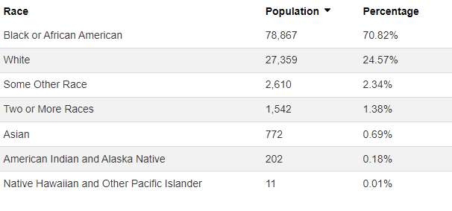
Miami Gardens Demographics

Slide 4
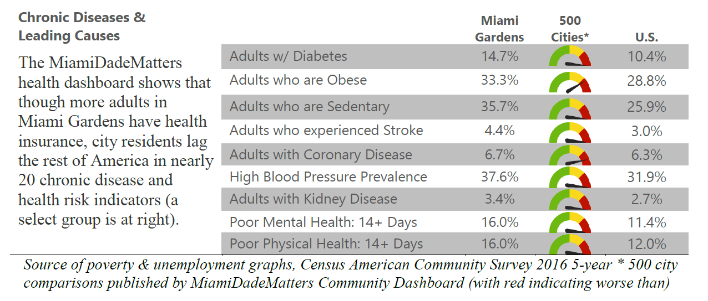
Health Disparities in CMG

Slide 5
LHMG Introduction and History

Slide 6
Overview of Live Healthy Miami Gardens
Started in 2014 as a partnership between the HFSF and the CMG. Currently funded primarily by the CDC.
Part of the City’s strategic effort to reduce poor health outcomes by engaging community residents to improve selected public health indicators.
Primary Goal - Make the CMG a healthier place to live, work and play.
Multi-disciplinary/ cross-sector collaboration- currently 100 individuals and 68 organizations.

Slide 7
Collective Impact Initiative
Network of community members, organizations, and institutions who advance equity by learning together, aligning, and integrating their actions to achieve population and systems level change
100 individuals and 68 organizations
Unified Vision & Commitment
Community Engagement

Slide 8
Community Partners
Notes:
Sub-Councils have also been formed for each of the priority areas, bringing in even more representation from community partners. Between the Host Council and the Sub-Councils, there are over 100 members representing 63 organizations. Although we believe that this is a great start, we know that in order to achieve true, lasting change in the community, there are additional leaders who are needed at the table.
(11) sectors: residents, non-profits, business, government, grass-roots organization, health and social service providers, faith-based organizations, police, schools, universities, and parks and recreation.

Slide 9
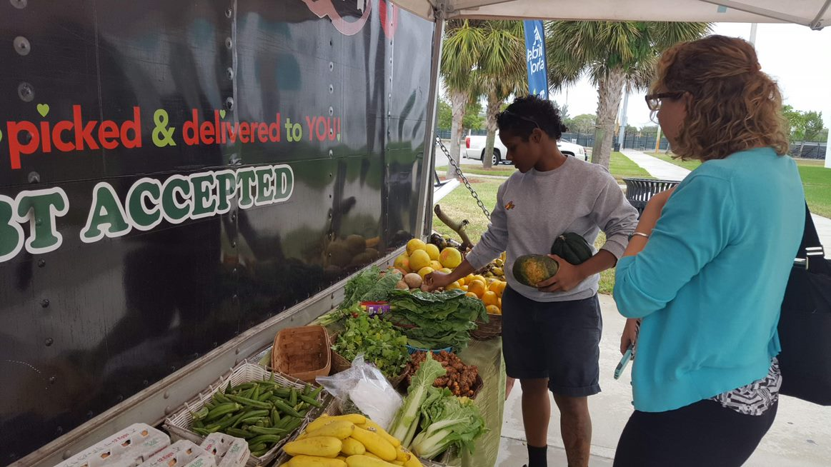
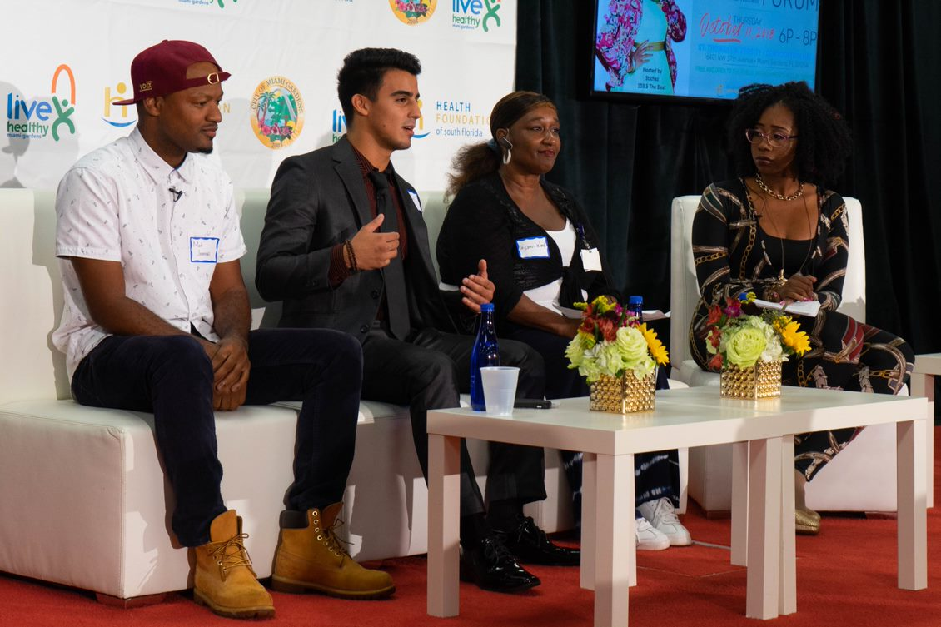
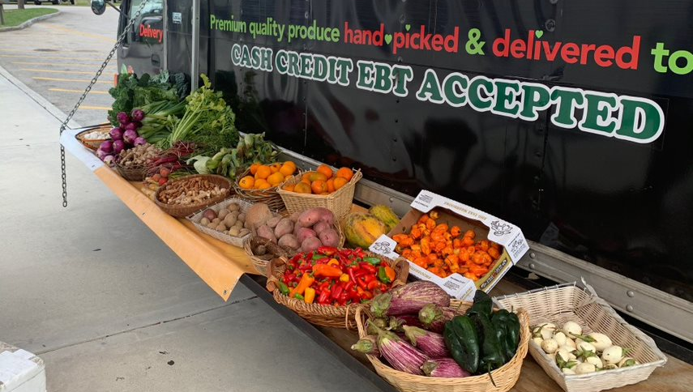
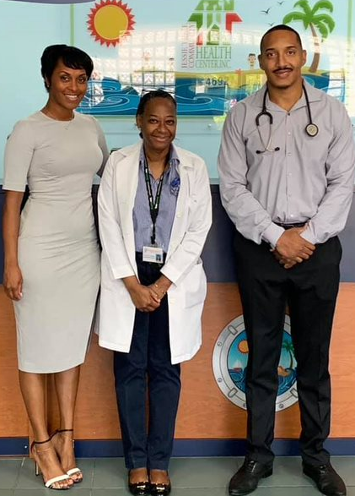
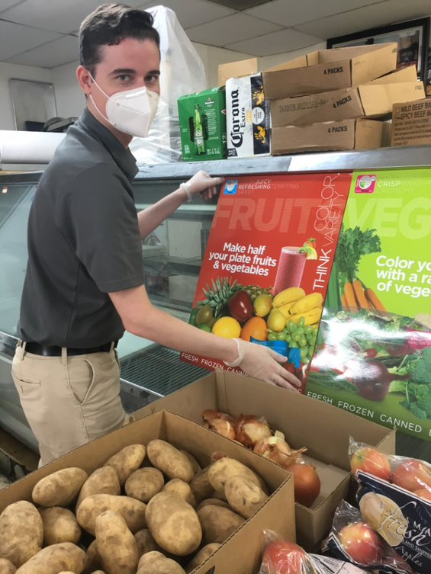
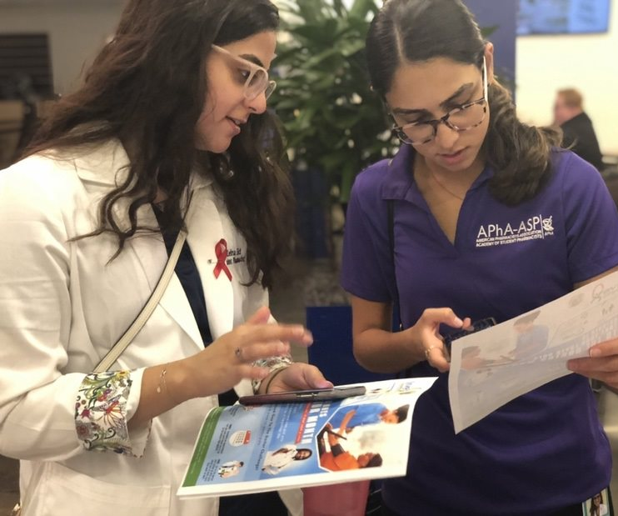
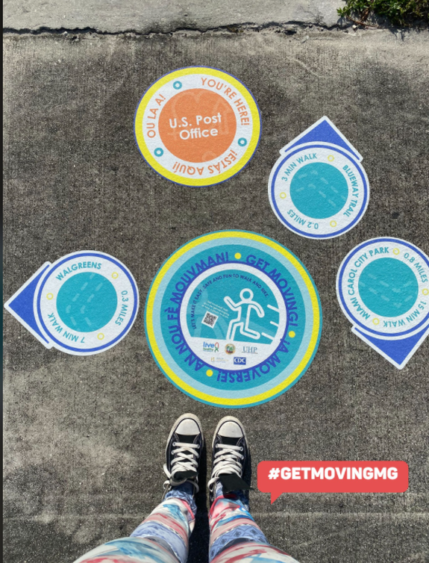
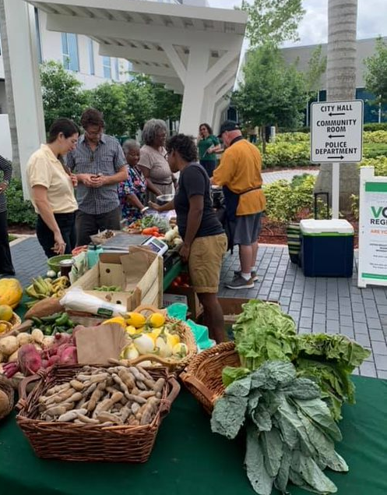
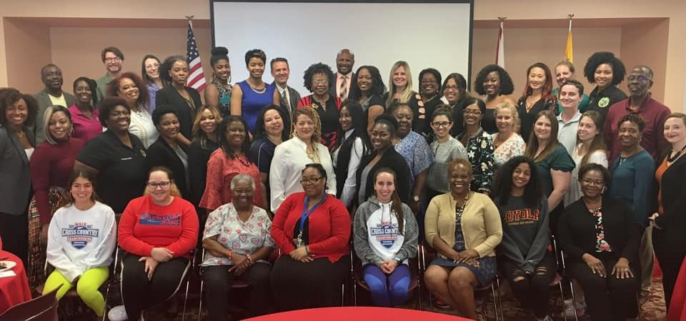
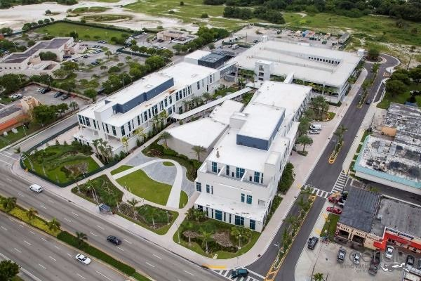
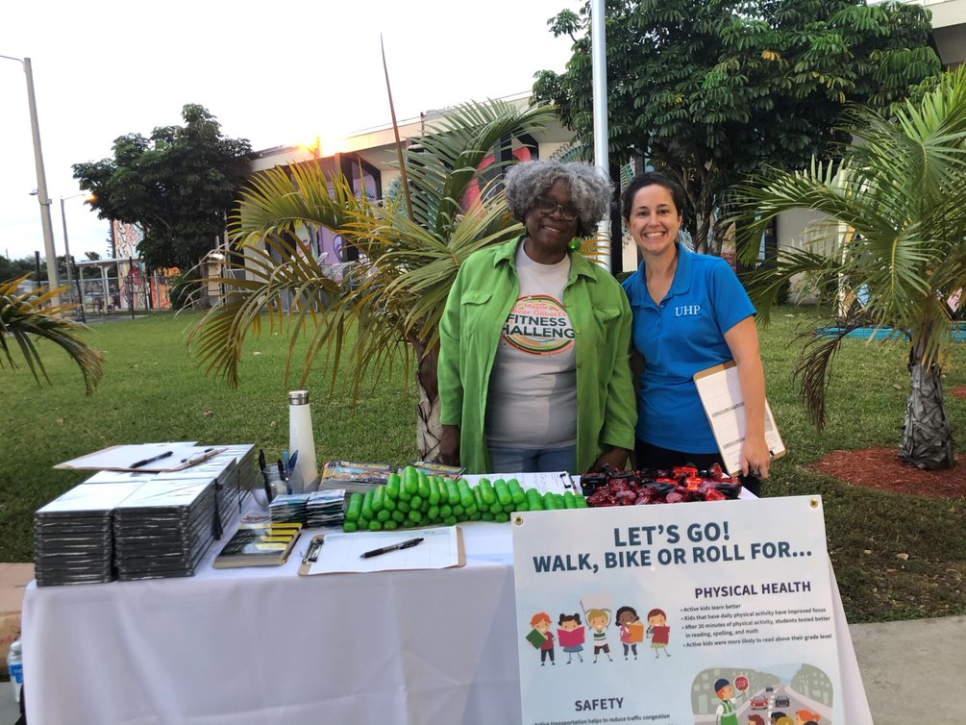
How Did
We Get Here?

Slide 10
Data Gathering Process
HCSF integrated existing MG health data relevant to the HIAs.
Report produced was based on the latest data, local reports & integration of neighborhood-specific data sets.
Comparisons by race, ethnicity and gender were provided where data was available to determine the relative health of the population.
By characterizing leading health issues, the report offered a view of key trends influencing the health of MG residents.
Data Committee formed to analyze data & ID data gaps
Committee compiled & analyzed data on 10 impact areas
Data Summaries created for each HIA
Committee compiled & analyzed additional Data including Community Check- Ins Data

Slide 11
Health Impact Areas of Focus
Health Impact Areas
ATOD
Mental Health
Primary Health Care
Nutrition
Physical Activity

Slide 12
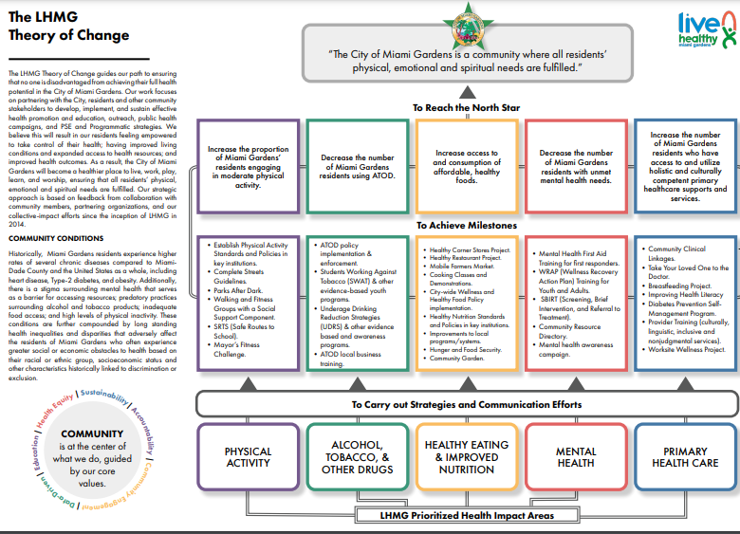
Root cause analysis
Unified Measurement
Resource Development
Evaluation

Slide 13
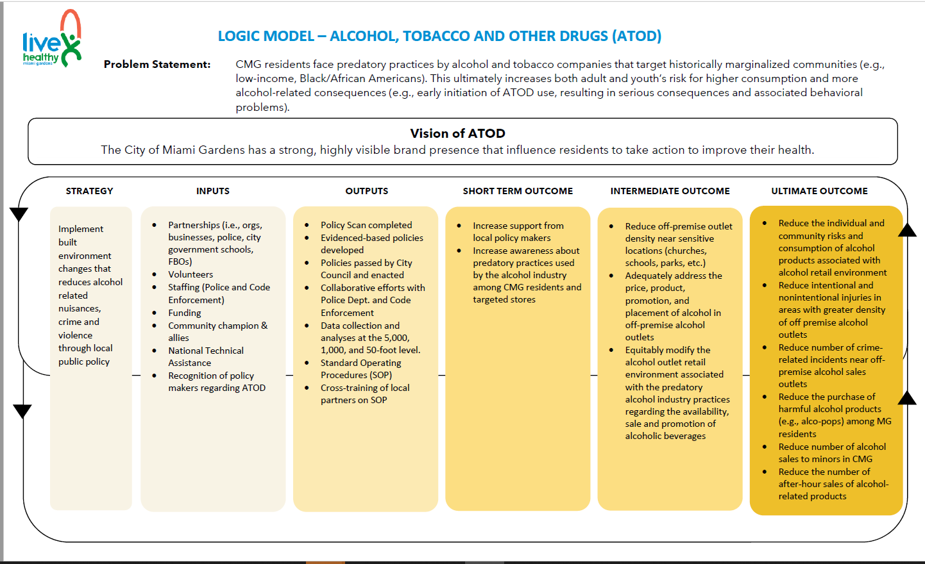

Slide 14
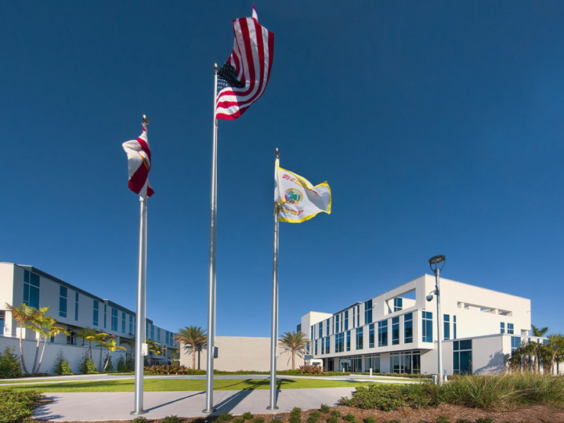
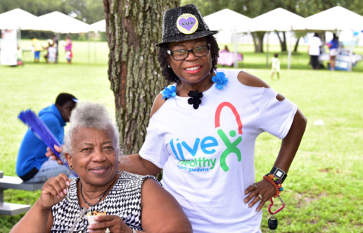
Policy, System & Environment (PSE)
PSE (Policy, System & Environmental) change approaches seek to go beyond programming and into the systems that create the structures in which we work, live and play.
PSE strategies are designed to promote healthy behaviors by making healthy choices readily available and easily accessible in the community.
PSE approach should seek to reach populations and uncover strategies for impact that are sustainable.
Incorporation of strategies in City’s existing plans and priorities.

Slide 15
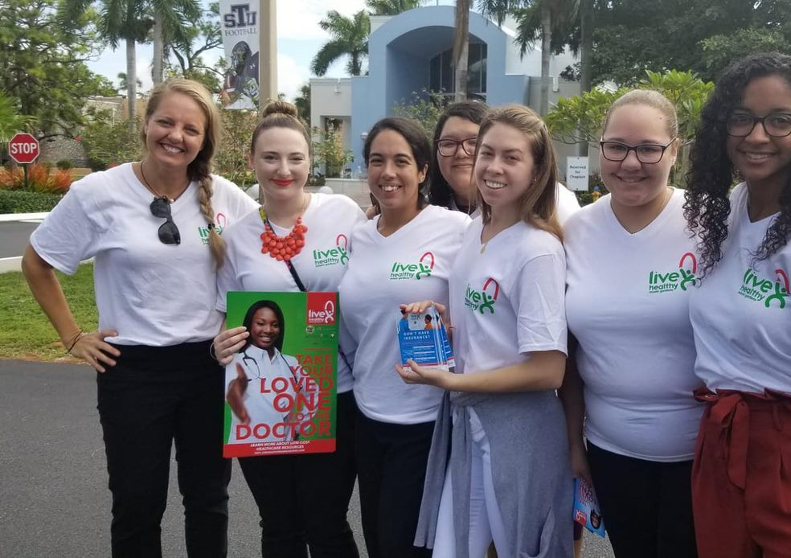
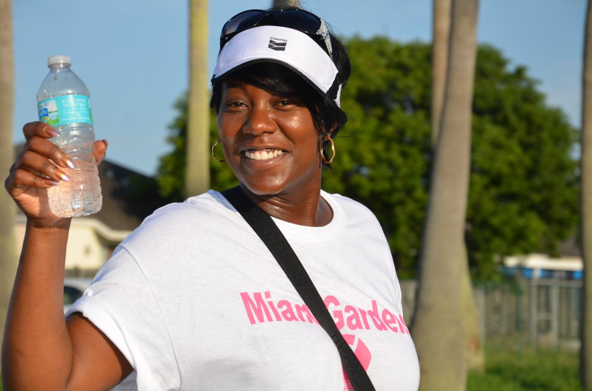
Programs Vs. PSE Changes
Programs
Policy, Systems & Environmental Change
One time
Often results in only short-term behavior
Individual level
Not part of ongoing plan
Non-sustaining
Ongoing
Often produces behavior change over time
Policy level
Part of an ongoing plan
Long term
sustaining

Slide 16
Community
Engagement & Input

Slide 17
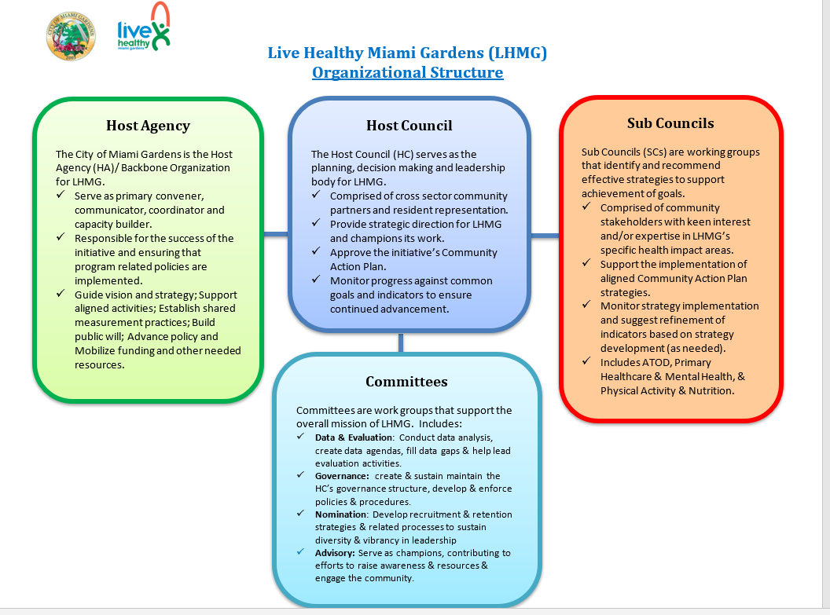

Slide 18
Other Community Input Efforts
Community Check-In Process
Surveys and Focus Groups
Development of Community Action Plan (CAP)
Selection of Health Impact Areas (HIAs)
Prioritization of Strategies
Faith-Based Community Study
Diabetes Survey
Constant communication, neutral facilitation & coordination

Slide 19
Community Leadership
Emphasis is placed on:
Working with neighborhood residents as leaders, “owners” and implementers of neighborhood transformation efforts
Community stakeholders and residents are engaged in every part of the process including holding leadership roles and capacity building to strengthen skills/knowledge
Creating strategic and accountable partnerships that engage multiple sectors and share accountability for results
Joint Decision Making
Collecting, analyzing and using data for learning and accountability
Building public and political will
Deepening organizational and leadership capacity

Slide 21
Training & Capacity Building
Result Based Accountability
PSE
Meeting Facilitation
Governance and Decision Making
Grant Writing and Resource Development
Media and Communications

Slide 22
Examples of Health Access Programs

Slide 23
Health Access Programs
Take Your Loved One to the Doctor
Community Clinical Linkages
Breastfeeding Touchpoint Program
Vaccination Project - Covid and Flu

Slide 24
Challenges
&
Lessons Learned

Slide 25
Challenges
Data Gaps
Time Constraints and Competing Priorities
Sustaining Momentum
Measuring Community Progress

Slide 26
Lessons Learned
Community Visioning
Engagement
Communication and Relationship Building
Community/Resident
Cross Sector
Lead Agency (buy in, leadership, competence, community trust)
Community Ownership, Governance and Joint Decision Making
Leadership Development
Collective Impact Model
Clear articulation of stakeholder Roles & Responsibilities
accountability & ownership
Achieving adequate balance b/t prescriptive & flexibility

